Slide 1
Python
DAY 1

Slide 2
AGENDA
INTRODUCTION
Overview
What can you do with Python?
Installation & Setting up Path
Running Python
BASIC PROGRAMMING
Basic Syntax
Variable types
Basic Operators

Slide 3
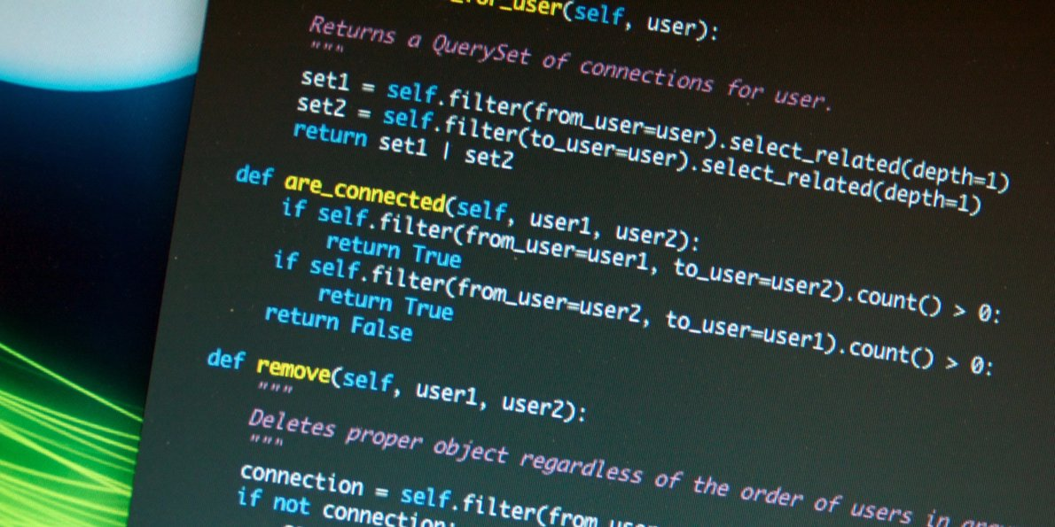
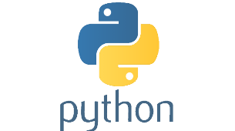
INTRODUCTION
WHAT IS PYTHON?
Python is a general-purpose interpreted, interactive, object-oriented, and high-level programming language. It was created by Guido van Rossum during 1985- 1990. Like Perl, Python source code is also available under the GNU General Public License (GPL). Python can be described as -
High-level
Interpreted
Interactive
Object-Oriented Scripting Language
Uses English keywords
Easy Language
Portable
This tutorial is designed for software programmers who need to learn Python programming language from scratch.
Notes:
Python is a high-level, interpreted, interactive and object-oriented scripting language. Python is designed to be highly readable. It uses English keywords frequently where as other languages use punctuation, and it has fewer syntactical constructions than other languages.
Python is Interpreted − Python is processed at runtime by the interpreter. You do not need to compile your program before executing it. This is similar to PERL and PHP.
Python is Interactive − You can actually sit at a Python prompt and interact with the interpreter directly to write your programs.
Python is Object-Oriented − Python supports Object-Oriented style or technique of programming that encapsulates code within objects.
Python is a Beginner's Language − Python is a great language for the beginner-level programmers and supports the development of a wide range of applications from simple text processing to WWW browsers to games.

Slide 4
INTRODUCTION
WHAT CAN YOU DO WITH PYTHON?
Python is used to create web and desktop applications, and some of the most popular web applications like Instagram, YouTube, Spotify all has been developed in Python, and you can also develop next big thing by using Python.
Web Development
Web Development
Frameworks:
Pyramid
Django
Flask, etc
Data Analysis
Data analysis libraries:
NumPy
Pandas
Matplotlib
Seaborn
Machine Learning
Machine Learning libraries:
Scikit-Learn
NLTK
Tensorfow
Computer Vision
Face Detection
Color Detection
Using OpenCV and Python
Raspberry Pi
Robotics
Automation
Game Development
Modules:
Pygame
Browser Automation
Selenium with Python
GUI Development
Modules:
Tkinter
PyQt
Writing Scripts

Slide 5
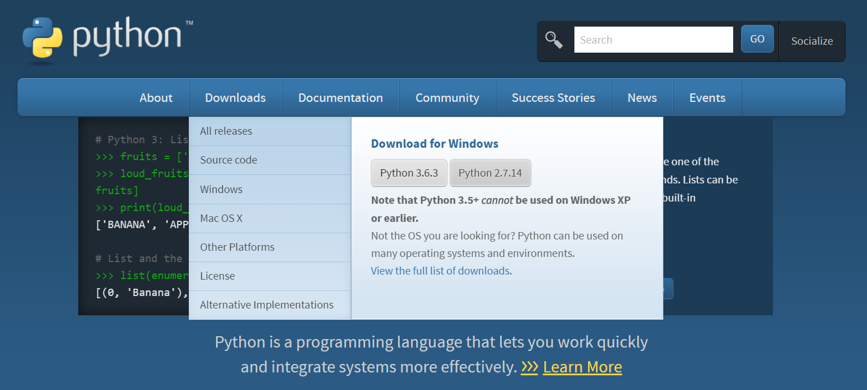
INTRODUCTION
INSTALLATION
LINUX
The Python interpreter is usually installed as: /usr/local/bin/python on those machines where it is available; putting: /usr/local/bin in your UNIX shell’s search path makes it possible to start it by typing the command “python” to the shell. Python 3 can be installed On Ubuntu Linux by using the following command from terminal.
WINDOWS
On Windows machines, the Python installation is usually placed in C:\Users\UserName\AppData\Local\Programs\Python\Python(Version),. though you can change this when you’re running the installer.
The latest version of python binaries are available on this link: https://www.python.org/downloads/windows/
$sudo apt-get install python3-minimal

Slide 6
INTRODUCTION
SETTING UP PATH
Setting path at Unix/Linux
To add the Python directory to the path for a particular session in Unix −
In the csh shell − type setenv PATH "$PATH:/usr/local/bin/python" and press Enter.
In the bash shell (Linux) − type export PATH="$PATH:/usr/local/bin/python" and press Enter.
In the sh or ksh shell − type PATH="$PATH:/usr/local/bin/python" and press Enter.
Note − /usr/local/bin/python is the path of the Python directory
ma.a.d.serrano@PISI-7091S2N-LX MINGW64 ~/Desktop/python/scripts
$ export PATH="$PATH:/c/Users/ma.a.d.serrano/AppData/Local/Programs/Python/Python36-32/python"
ma.a.d.serrano@PISI-7091S2N-LX MINGW64 ~/Desktop/python/scripts
$ which python
/c/Users/ma.a.d.serrano/AppData/Local/Programs/Python/Python36-32/python
Notes:
Programs and other executable files can be in many directories, so operating systems provide a search path that lists the directories that the OS searches for executables.
The path is stored in an environment variable, which is a named string maintained by the operating system. This variable contains information available to the command shell and other programs.
The path variable is named as PATH in Unix or Path in Windows (Unix is case sensitive; Windows is not).
In Mac OS, the installer handles the path details. To invoke the Python interpreter from any particular directory, you must add the Python directory to your path.

Slide 7
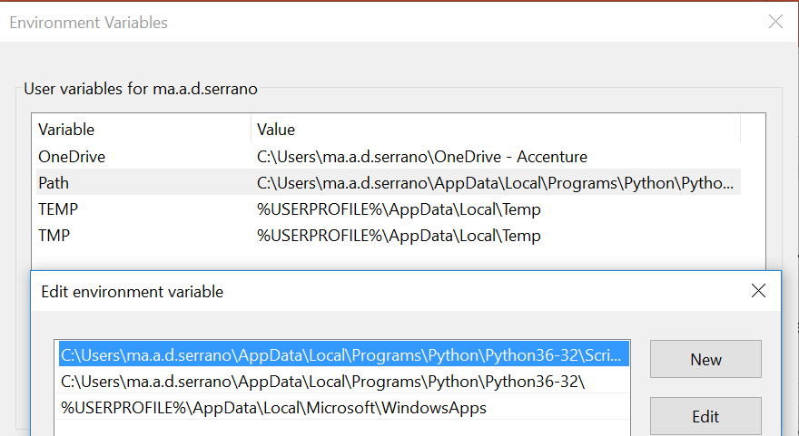
INTRODUCTION
SETTING UP PATH
Setting path at Windows
To add the Python directory to the path for a particular session in Windows −
At the command prompt − type path %path%;C:\Python and press Enter.
Got to the Environment Variables Window and add Path or python installation
Notes:
Programs and other executable files can be in many directories, so operating systems provide a search path that lists the directories that the OS searches for executables.
The path is stored in an environment variable, which is a named string maintained by the operating system. This variable contains information available to the command shell and other programs.
The path variable is named as PATH in Unix or Path in Windows (Unix is case sensitive; Windows is not).
In Mac OS, the installer handles the path details. To invoke the Python interpreter from any particular directory, you must add the Python directory to your path.

Slide 8
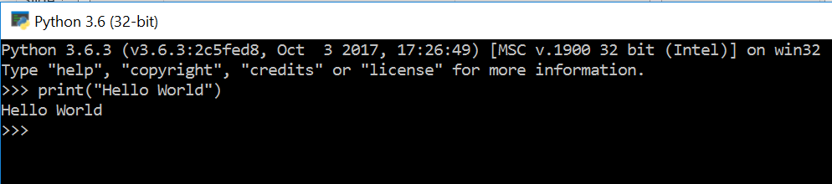
INTRODUCTION
RUNNING PYTHON
There are three different ways to start Python −
I. INTERACTIVE INTERPRETER
You can start Python from Unix, DOS, or any other system that provides you a command-line interpreter or shell window.

Slide 9
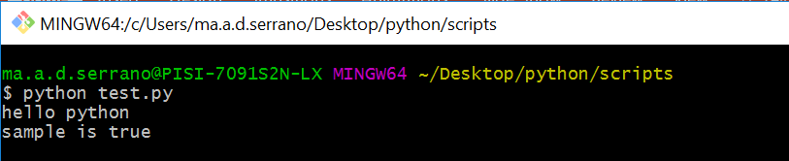
INTRODUCTION
RUNNING PYTHON
There are three different ways to start Python −
II. SCRIPT FROM THE COMMAND LINE
A Python script can be executed at command line (either dos or git bash) by invoking the interpreter on your application, as in the following −

Slide 10
INTRODUCTION
RUNNING PYTHON
There are three different ways to start Python −
III. INTEGRATED DEVELOPMENT ENVIRONMENT (IDE)
You can run Python from a Graphical User Interface (GUI) environment as well, if you have a GUI application on your system that supports Python.
Unix − IDLE is the very first Unix IDE for Python.
Windows − PythonWin is the first Windows interface for Python and is an IDE with a GUI.
Macintosh − The Macintosh version of Python along with the IDLE IDE is available from the main website, downloadable as either MacBinary or BinHex'd files.

Slide 11
INTRODUCTION
AVAILABLE PYTHON IDE
Some of the available Python IDEs that you may use are the following:
IDE | Supported OS | Features | Terms
PyCharm | Windows, MacOS and Linux support | Designed for Python, Javascript, Coffeescript, Typescript, HTML/CSS, AngularJS, Node.js and more | Close Source
PyDev | Supported by all known Operating systems | Handles code completion, integrates Python debugging, adds a token browser, refactoring tools, and much more. | Open Source
Wing IDE | Windows, Linux and MacOS support | has a powerful debugger that allows setting breakpoints, stepping through code, inspecting data, debugging remotely, and debugging Django templates. | Close Sourced
Komodo IDE | Windows, MacOS and Linux support | Includes basic features like code refactoring, auto complete, calltips, brackets matching, code browser, go to definition, graphical debugging, multi process debugging, multithreaded debugging, breakpoint configuration, code profiling, integrated unit testing and integration with third party libraries like pyWin32. | Close Source
Eric | Windows | Has features such as Python and Ruby debugger, code coverage, automatic code checking, Python and Ruby shell, class browser, and others. And it has features for collaborative editing. | Open Sourced
Eclipse | All OS | Open-source IDEs and supports a whole ecosystem of languages | Open Source
Spyder | Windows | Some of the basic features of Spyder python are multi language editor, interactive console, documentation viewer, variable explorer, Find in files, files explorer etc. | Open Source
PyScripter | Windows | Supports projects, editing files and debugging | Open Source
IDLE | Windows, Linux, MacOS, Raspbian | It is quite helpful to try out small Python snippets and experiment with different features in Python. | Open Source
Geaney | Cross-Platform (Linux, Windows and OSX) | Small and fast | Open Source

Slide 12
BASIC SYNTAX

Slide 13
BASIC SYNTAX
PYTHON IDENTIFIERS
A Python identifier is a name used to identify a variable, function, class, module or other object. An identifier starts with a letter A to Z or a to z or an underscore (_) followed by zero or more letters, underscores and digits (0 to 9).
Python does not allow punctuation characters such as @, $, and % within identifiers. Python is a case sensitive programming language. Thus, Manpower and manpower are two different identifiers in Python.
Here are naming conventions for Python identifiers −
Class names start with an uppercase letter. All other identifiers start with a lowercase letter.
Starting an identifier with a single leading underscore indicates that the identifier is private.
Starting an identifier with two leading underscores indicates a strongly private identifier.
If the identifier also ends with two trailing underscores, the identifier is a language-defined special name.

Slide 14
BASIC SYNTAX
RESERVED WORDS
The following list shows the Python keywords. These are reserved words and you cannot use them as constant or variable or any other identifier names. All the Python keywords contain lowercase letters only.
and | exec | not
assert | finally | or
break | for | pass
class | from | print
continue | global | raise
def | if | return
del | import | try
elif | in | while
else | is | with
except | lambda | yield

Slide 15
BASIC SYNTAX
LINES AND INDENTION
Python provides no braces to indicate blocks of code for class and function definitions or flow control. Blocks of code are denoted by line indentation, which is rigidly enforced.
The number of spaces in the indentation is variable, but all statements within the block must be indented the same amount.
For example:
However, the following block generates an error −
if True:
print("True")
else:
print("False")
if True:
print("Answer“)
print("True")
else:
print("Answer")
print("False")
Thus, in Python all the continuous lines indented with same number of spaces would form a block.

Slide 16
BASIC SYNTAX
MULTI-LINE STATEMENTS
Statements in Python typically end with a new line. Python does, however, allow the use of the line continuation character (\) to denote that the line should continue. For example −
total = item_one + \
item_two + \
item_three
Statements contained within the [], {}, or () brackets do not need to use the line continuation character.
For example -
days = ['Monday', 'Tuesday', 'Wednesday', 'Thursday', 'Friday']

Slide 17
BASIC SYNTAX
QUOTATION IN PYTHON
Python accepts single ('), double (") and triple (''' or """) quotes to denote string literals, as long as the same type of quote starts and ends the string. The triple quotes are used to span the string across multiple lines.
For example, all the following are legal −
COMMENTS IN PYTHON
A hash sign (#) that is not inside a string literal begins a comment. All characters after the # and up to the end of the physical line are part of the comment and the Python interpreter ignores them.
#!/usr/bin/python
# First comment
Print("Hello, Python!") # second comment
word = 'word’
sentence = "This is a sentence."
paragraph = """This is a paragraph.
It is made up of multiple lines and sentences."""
This produces the ff result -
Hello, Python!

Slide 18
BASIC SYNTAX
USING BLANK LINES
A line containing only whitespace, possibly with a comment, is known as a blank line and Python totally ignores it. In an interactive interpreter session, you must enter an empty physical line to terminate a multiline statement.
Here, "\n\n" is used to create two new lines before displaying the actual line. Once the user presses the key, the program ends. This is a nice trick to keep a console window open until the user is done with an application.
WAITING FOR THE USER
The following line of the program displays the prompt, the statement saying “Press the enter key to exit”, and waits for the user to take action −
ma.a.d.serrano@PISI-7091S2N-LX MINGW64 ~/Desktop/python/scripts
$ python raw.py
Press the enter key to exit.
#!/usr/bin/python
input("\n\nPress the enter key to exit.")

Slide 19
BASIC SYNTAX
MULTIPLE STATEMENTS ON A SINGLE LINE
The semicolon ( ; ) allows multiple statements on the single line given that neither statement starts a new code block.
Here is a sample snip using the semicolon −
MULTIPLE STATEMENTS GROUPS AS SUITES
A group of individual statements, which make a single code block are called suites in Python. Compound or complex statements, such as if, while, def, and class require a header line and a suite.
Header lines begin the statement (with the keyword) and terminate with a colon ( : ) and are followed by one or more lines which make up the suite.
For example −
import sys; x = 'foo'; sys.stdout.write(x + '\n')
if expression :
suite
elif expression :
suite
else :
suite

Slide 20
BASIC SYNTAX
COMMAND LINE ARGUMENTS
Many programs can be run to provide you with some basic information about how they should be run. Python enables you to do this with -h −
$ python -h
usage: python [option] ... [-c cmd | -m mod | file | -] [arg] ...
Options and arguments (and corresponding environment variables):
-c cmd : program passed in as string (terminates option list)
-d : debug output from parser (also PYTHONDEBUG=x)
-E : ignore environment variables (such as PYTHONPATH)
-h : print this help message and exit
[ etc. ]
You can also program your script in such a way that it should accept various options. Command Line Arguments is an advanced topic and should be studied a bit later once you have gone through rest of the Python concepts.

Slide 21
VARIABLE TYPES

Slide 22
VARIABLE TYPES
Variables are nothing but reserved memory locations to store values. This means that when you create a variable you reserve some space in memory.
Based on the data type of a variable, the interpreter allocates memory and decides what can be stored in the reserved memory. Therefore, by assigning different data types to variables, you can store integers, decimals or characters in these variables.

Slide 23
VARIABLE TYPES
ASSIGNING VALUES TO VARIABLES
Python variables do not need explicit declaration to reserve memory space. The declaration happens automatically when you assign a value to a variable. The equal sign (=) is used to assign values to variables.
The operand to the left of the = operator is the name of the variable and the operand to the right of the = operator is the value stored in the variable.
#!/usr/bin/python
counter = 100 # An integer assignment
miles = 1000.0 # A floating point
name = "John" # A string
print(counter)
print(miles)
print(name)
Here, 100, 1000.0 and "John" are the values assigned to counter, miles, and name variables, respectively.
ma.a.d.serrano@PISI-7091S2N-LX MINGW64 ~/Desktop/python/scripts
$ python counter.py
100
1000.0
John

Slide 24
VARIABLE TYPES
MULTIPLE ASSIGNMENT
Python allows you to assign a single value to several variables simultaneously. For example −
It will produce the ff result:
ma.a.d.serrano@PISI-7091S2N-LX MINGW64 ~/Desktop/python/scripts
$ cat var.py
a,b,c = 1,2,"john"
print(a,b,c)
ma.a.d.serrano@PISI-7091S2N-LX MINGW64 ~/Desktop/python/scripts
$ python var.py
1 2 john
a = b = c = 1
Here, an integer object is created with the value 1, and all three variables are assigned to the same memory location. You can also assign multiple objects to multiple variables.
For example −
a,b,c = 1,2,"john"
Here, two integer objects with values 1 and 2 are assigned to variables a and b respectively, and one string object with the value "john" is assigned to the variable c.

Slide 25
VARIABLE TYPES
STANDARD DATA TYPES
The data stored in memory can be of many types. For example, a person's age is stored as a numeric value and his or her address is stored as alphanumeric characters. Python has various standard data types that are used to define the operations possible on them and the storage method for each of them.
Python has five standard data types −
Numbers
String
List
Tuple
Dictionary

Slide 26
VARIABLE TYPES
I. PYTHON NUMBERS
Number data types store numeric values. Number objects are created when you assign a value to them.
For example −
You can delete a single object or multiple objects by using the del statement.
For example −
del var
del var_a, var_b
var1 = 1
var2 = 10
Python supports four different numerical types −
int (signed integers)
long (long integers, they can also be represented in octal and hexadecimal)
float (floating point real values)
complex (complex numbers)
You can also delete the reference to a number object by using the del statement. The syntax of the del statement is −
del var1[,var2[,var3[....,varN]]]]

Slide 27
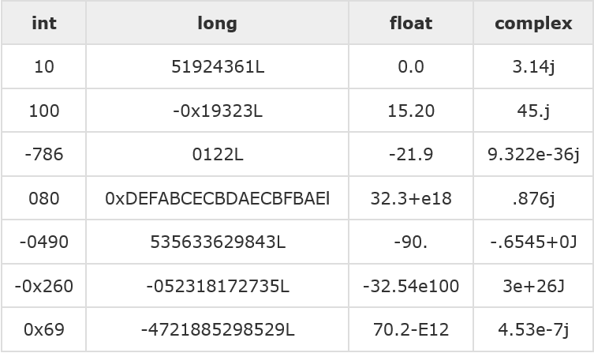
VARIABLE TYPES
Here are some examples of numbers −
Python allows you to use a lowercase l with long, but it is recommended that you use only an uppercase L to avoid confusion with the number 1. Python displays long integers with an uppercase L.
A complex number consists of an ordered pair of real floating-point numbers denoted by x + yj, where x and y are the real numbers and j is the imaginary unit.
Notes:
Python supports four different numerical types −
int (signed integers) − They are often called just integers or ints, are positive or negative whole numbers with no decimal point.
long (long integers ) − Also called longs, they are integers of unlimited size, written like integers and followed by an uppercase or lowercase L.
float (floating point real values) − Also called floats, they represent real numbers and are written with a decimal point dividing the integer and fractional parts. Floats may also be in scientific notation, with E or e indicating the power of 10 (2.5e2 = 2.5 x 10² = 250).
complex (complex numbers) − are of the form a + bJ, where a and b are floats and J (or j) represents the square root of -1 (which is an imaginary number). The real part of the number is a, and the imaginary part is b. Complex numbers are not used much in Python programming.

Slide 28
VARIABLE TYPES
MATHEMATICAL FUNCTIONS
FUNCTIONS | RETURNS
abs(x) | The absolute value of x: the (positive) distance between x and zero.
ceil(x) | The ceiling of x: the smallest integer not less than x
cmp(x, y) | -1 if x < y, 0 if x == y, or 1 if x > y
exp(x) | The exponential of x: e^{x}
fabs(x) | The absolute value of x.
floor(x) | The floor of x: the largest integer not greater than x
log(x) | The natural logarithm of x, for x> 0
log10(x) | The base-10 logarithm of x for x> 0.
max(x1, x2,...) | The largest of its arguments: the value closest to positive infinity
min(x1, x2,...) | The smallest of its arguments: the value closest to negative infinity
modf(x) | The fractional and integer parts of x in a two-item tuple. Both parts have the same sign as x. The integer part is returned as a float.
pow(x, y) | The value of x**y.
round(x [,n]) | x rounded to n digits from the decimal point. Python rounds away from zero as a tie-breaker: round(0.5) is 1.0 and round(-0.5) is -1.0.
sqrt(x) | The square root of x for x > 0

Slide 29
VARIABLE TYPES
MATHEMATICAL FUNCTIONS - EXAMPLE
OUTPUT
import math # This will import math module
print("abs(-45) : ", abs(-45))
print("math.ceil(-45.17) : ", math.ceil(-45.17))
print("math.exp(-45.17) : ", math.exp(-45.17))
print("math.fabs(-45.17) : ", math.fabs(-45.17))
print("math.floor(-45.17) : ", math.floor(-45.17))
print("math.log(100.12) : ", math.log(100.12))
print("math.log10(100.12) : ", math.log10(100.12))
print("max(80, 100, 1000) : ", max(80, 100, 1000))
print("min(80, 100, 1000) : ", min(80, 100, 1000))
print("math.modf(100.12) : ", math.modf(100.12))
print("math.pow(100, 2) : ", math.pow(100, 2))
print("round(80.23456, 2) : ", round(80.23456, 2))
print("math.sqrt(math.pi) : ", math.sqrt(math.pi))
ma.a.d.serrano@PISI-7091S2N-LX MINGW64 ~/Desktop/python/scripts/loops
$ python math.py
abs(-45) : 45
math.ceil(-45.17) : -45
math.exp(-45.17) : 2.4150062132629406e-20
math.fabs(-45.17) : 45.17
math.floor(-45.17) : -46
math.log(100.12) : 4.6063694665635735
math.log10(100.12) : 2.0005208409361854
max(80, 100, 1000) : 1000
min(80, 100, 1000) : 80
math.modf(100.12) : (0.12000000000000455, 100.0)
math.pow(100, 2) : 10000.0
round(80.23456, 2) : 80.23
math.sqrt(math.pi) : 1.7724538509055159

Slide 30
VARIABLE TYPES
RANDOM NUMBER FUNCTIONS
FUNCTION | DESCRIPTION
choice(seq) | A random item from a list, tuple, or string.
randrange ([start,] stop [,step]) | A randomly selected element from range(start, stop, step)
random() | A random float r, such that 0 is less than or equal to r and r is less than 1
seed([x]) | Sets the integer starting value used in generating random numbers. Call this function before calling any other random module function. Returns None.
shuffle(lst) | Randomizes the items of a list in place. Returns None.
uniform(x, y) | A random float r, such that x is less than or equal to r and r is less than y

Slide 31
VARIABLE TYPES
RANDOM NUMBER FUNCTIONS - EXAMPLE
OUTPUT
import random
# Print Random choice
print("choice([1, 2, 3, 5, 9]) : ", random.choice([1, 2, 3, 5, 9]))
# Select an even number in 100 <= number < 1000
print("randrange(100, 1000, 2) : ", random.randrange(100, 1000, 2))
# First random number
print("random() : ", random.random())
# Random number with seed 10
random.seed( 10 )
print("Random number with seed 10 : ", random.random())
# Random shuffled list
list = [20, 16, 10, 5];
random.shuffle(list)
print("Reshuffled list : ", list)
# Random float
print("Random Float uniform(5, 10) : ", random.uniform(5, 10))
ma.a.d.serrano@PISI-7091S2N-LX MINGW64 ~/Desktop/python/scripts/loops
$ python ran.py
choice([1, 2, 3, 5, 9]) : 9
randrange(100, 1000, 2) : 742
random() : 0.10955903689943769
Random number with seed 10 : 0.5714025946899135
Reshuffled list : [10, 20, 16, 5]
Random Float uniform(5, 10) : 6.030491160697508
055159

Slide 32
VARIABLE TYPES
TRIGONOMETRIC FUNCTIONS
Function | Description
acos(x) | Return the arc cosine of x, in radians.
asin(x) | Return the arc sine of x, in radians.
atan(x) | Return the arc tangent of x, in radians.
atan2(y, x) | Return atan(y / x), in radians.
cos(x) | Return the cosine of x radians.
hypot(x, y) | Return the Euclidean norm, sqrt(x*x + y*y).
sin(x) | Return the sine of x radians.
tan(x) | Return the tangent of x radians.
degrees(x) | Converts angle x from radians to degrees.
radians(x) | Converts angle x from degrees to radians.

Slide 33
VARIABLE TYPES
TRIGONOMETRIC FUNCTIONS - EXAMPLE
OUTPUT
import math
print("acos(0.64) : ", math.acos(0.64))
print("asin(0.64) : ", math.asin(0.64))
print("atan(0.64) : ", math.atan(0.64))
print("atan2(-0.50,-0.50) : ", math.atan2(-0.50,-0.50))
print("cos(3) : ", math.cos(3))
print("hypot(3, 2) : ", math.hypot(3, 2))
print("sin(3) : ", math.sin(3))
print("tan(3) : ", math.tan(3))
print("degrees(3) : ", math.degrees(3))
print("radians(3) : ", math.radians(3))
ma.a.d.serrano@PISI-7091S2N-LX MINGW64 ~/Desktop/python/scripts/loops
$ python trigo.py
acos(0.64) : 0.8762980611683406
asin(0.64) : 0.694498265626556
atan(0.64) : 0.5693131911006619
atan2(-0.50,-0.50) : -2.356194490192345
cos(3) : -0.9899924966004454
hypot(3, 2) : 3.6055512754639896
sin(3) : 0.1411200080598672
tan(3) : -0.1425465430742778
degrees(3) : 171.88733853924697
radians(3) : 0.05235987755982989055159

Slide 34
VARIABLE TYPES
MATHEMATICAL CONSTANTS
Function | Description
pi | Mathematical constant pi
e | Mathematical constant e

Slide 35
VARIABLE TYPES
II. PYTHON STRINGS
Strings in Python are identified as a contiguous set of characters represented in the quotation marks. Python allows for either pairs of single or double quotes. Subsets of strings can be taken using the slice operator ([ ] and [:] ) with indexes starting at 0 in the beginning of the string and working their way from -1 at the end.
The plus (+) sign is the string concatenation operator and the asterisk (*) is the repetition operator.
For example −
#!/usr/bin/python
str = 'Hello World!'
print(str) # Prints complete string
print(str[0]) # Prints first character of the string
print(str[2:5]) # Prints characters starting from 3rd to 5th
print(str[2:]) # Prints string starting from 3rd character
print(str * 2) # Prints string two times
print(str + "TEST") # Prints concatenated string

Slide 36
VARIABLE TYPES
This will produce the ff result:
ma.a.d.serrano@PISI-7091S2N-LX MINGW64 ~/Desktop/python/scripts
$ python print.py
Hello World!
H
llo
llo World!
Hello World!Hello World!
Hello World!TEST

Slide 37
VARIABLE TYPES
ESCAPE CHARACTERS
Following table is a list of escape or non-printable characters that can be represented with backslash notation.
An escape character gets interpreted; in a single quoted as well as double quoted strings.
Backslash notation | Hexadecimal character | Description
\a | 0x07 | Bell or alert
\b | 0x08 | Backspace
\cx |  | Control-x
\C-x |  | Control-x
\e | 0x1b | Escape
\f | 0x0c | Formfeed
\M-\C-x |  | Meta-Control-x
\n | 0x0a | Newline
\nnn |  | Octal notation, where n is in the range 0.7
\r | 0x0d | Carriage return
\s | 0x20 | Space
\t | 0x09 | Tab
\v | 0x0b | Vertical tab
\x |  | Character x
\xnn |  | Hexadecimal notation, where n is in the range 0.9, a.f, or A.F

Slide 38
VARIABLE TYPES
STRING SPECIAL OPERATORS
Assume string variable a holds 'Hello' and variable b holds 'Python', then −
Operator | Description | Example
+ | Concatenation - Adds values on either side of the operator | a + b will give HelloPython
* | Repetition - Creates new strings, concatenating multiple copies of the same string | a*2 will give -HelloHello
[] | Slice - Gives the character from the given index | a[1] will give e
[ : ] | Range Slice - Gives the characters from the given range | a[1:4] will give ell
in | Membership - Returns true if a character exists in the given string | H in a will give 1
not in | Membership - Returns true if a character does not exist in the given string | M not in a will give 1
r/R | Raw String - Suppresses actual meaning of Escape characters. The syntax for raw strings is exactly the same as for normal strings with the exception of the raw string operator, the letter "r," which precedes the quotation marks. The "r" can be lowercase (r) or uppercase (R) and must be placed immediately preceding the first quote mark. | print r'\n' prints \n and print R'\n'prints \n
% | Format - Performs String formatting | See at next section

Slide 39
VARIABLE TYPES
STRING FORMATTING OPERATOR
One of Python's coolest features is the string format operator %. This operator is unique to strings and makes up for the pack of having functions from C's printf() family. Following is a simple example −
print("My name is %s and weight is %d kg!" % ('Sam', 20))
When the above code is executed, it produces the following result −
ma.a.d.serrano@PISI-7091S2N-LX MINGW64 ~/Desktop/python/scripts/string
$ python format.py
My name is Sam and weight is 20 kg!

Slide 40
VARIABLE TYPES
Here is the list of complete set of symbols which can be used along with % −
Other supported symbols and functionality are listed in the following table −
Format Symbol | Conversion
%c | character
%s | string conversion via str() prior to formatting
%i | signed decimal integer
%d | signed decimal integer
%u | unsigned decimal integer
%o | octal integer
%x | hexadecimal integer (lowercase letters)
%X | hexadecimal integer (UPPERcase letters)
%e | exponential notation (with lowercase 'e')
%E | exponential notation (with UPPERcase 'E')
%f | floating point real number
%g | the shorter of %f and %e
%G | the shorter of %f and %E
Symbol | Functionality
* | argument specifies width or precision
- | left justification
+ | display the sign
<sp> | leave a blank space before a positive number
# | add the octal leading zero ( '0' ) or hexadecimal leading '0x' or '0X', depending on whether 'x' or 'X' were used.
0 | pad from left with zeros (instead of spaces)
% | '%%' leaves you with a single literal '%'
(var) | mapping variable (dictionary arguments)
m.n. | m is the minimum total width and n is the number of digits to display after the decimal point (if appl.)

Slide 41
VARIABLE TYPES
TRIPLE QUOTES
Python's triple quotes comes to the rescue by allowing strings to span multiple lines, including verbatim NEWLINEs, TABs, and any other special characters. The syntax for triple quotes consists of three consecutive single or double quotes.
Example:
Output:
para_str = """this is a long string that is made up of
several lines and non-printable characters such as
TAB ( \t ) and they will show up that way when displayed.
NEWLINEs within the string, whether explicitly given like
this within the brackets [ \n ], or just a NEWLINE within
the variable assignment will also show up.
"""
print(para_str)
ma.a.d.serrano@PISI-7091S2N-LX MINGW64 ~/Desktop/python/scripts/string
$ python triple.py
this is a long string that is made up of
several lines and non-printable characters such as
TAB ( ) and they will show up that way when displayed.
NEWLINEs within the string, whether explicitly given like
this within the brackets [
], or just a NEWLINE within
the variable assignment will also show up.
Notes:
Note how every single special character has been converted to its printed form, right down to the last NEWLINE at the end of the string between the "up." and closing triple quotes. Also note that NEWLINEs occur either with an explicit carriage return at the end of a line or its escape code (\n) −

Slide 42
VARIABLE TYPES
Raw strings do not treat the backslash as a special character at all. Every character you put into a raw string stays the way you wrote it
Example:
Output:
print 'C:\\nowhere'
ma.a.d.serrano@PISI-7091S2N-LX MINGW64 ~/Desktop/python/scripts/string
$ python pr.py
C:\nowhere

Slide 43
VARIABLE TYPES
BUILT IN STRING METHODS
Python includes the following built-in methods to manipulate strings −
Methods | Description
str.capitalize() | Capitalizes first letter of string
str.center(width, fillchar) | Returns a space-padded string with the original string centered to a total of width columns.
str.count(str, beg= 0,end=len(string)) | Counts how many times str occurs in string or in a substring of string if starting index beg and ending index end are given.
str.decode(encoding='UTF-8',errors='strict') | Decodes the string using the codec registered for encoding. encoding defaults to the default string encoding.
str.encode(encoding='UTF-8',errors='strict') | Returns encoded string version of string; on error, default is to raise a ValueError unless errors is given with 'ignore' or 'replace'.
str.endswith(suffix, beg=0, end=len(string)) | Determines if string or a substring of string (if starting index beg and ending index end are given) ends with suffix; returns true if so and false otherwise.
str.expandtabs(tabsize=8) | Expands tabs in string to multiple spaces; defaults to 8 spaces per tab if tabsize not provided.
str.find(str, beg=0 end=len(string)) | Determine if str occurs in string or in a substring of string if starting index beg and ending index end are given returns index if found and -1 otherwise.
str.index(str, beg=0, end=len(string)) | Same as find(), but raises an exception if str not found.

Slide 44
VARIABLE TYPES
Methods | Description
str.isalnum() | Returns true if string has at least 1 character and all characters are alphanumeric and false otherwise.
str.isalpha() | Returns true if string has at least 1 character and all characters are alphabetic and false otherwise.
str.isdecimal() | Returns true if a unicode string contains only decimal characters and false otherwise.
str.isdigit() | Returns true if string contains only digits and false otherwise.
str.islower() | Returns true if string has at least 1 cased character and all cased characters are in lowercase and false otherwise.
str.isnumeric() | Returns true if a unicode string contains only numeric characters and false otherwise.
str.isspace() | Returns true if string contains only whitespace characters and false otherwise.
str.istitle() | Returns true if string is properly "titlecased" and false otherwise.
str.isupper() | Returns true if string has at least one cased character and all cased characters are in uppercase and false otherwise.
str.len(string) | Returns the length of the string
str.ljust(width[, fillchar]) | Returns a space-padded string with the original string left-justified to a total of width columns.
str.lower() | Converts all uppercase letters in string to lowercase.
str.lstrip() | Removes all leading whitespace in string.
str.maketrans() | Returns a translation table to be used in translate function.

Slide 45
VARIABLE TYPES
Methods | Description
str.max(str) | Returns the max alphabetical character from the string str.
str.min(str) | Returns the min alphabetical character from the string str.
str.replace(old, new [, max]) | Replaces all occurrences of old in string with new or at most max occurrences if max given.
str.rfind(str, beg=0,end=len(string)) | Same as find(), but search backwards in string.
str.rindex( str, beg=0, end=len(string)) | Same as index(), but search backwards in string.
str.rjust(width,[, fillchar]) | Returns a space-padded string with the original string right-justified to a total of width columns.
str.rstrip() | Removes all trailing whitespace of string.
str.split(str="", num=string.count(str)) | Splits string according to delimiter str (space if not provided) and returns list of substrings; split into at most num substrings if given.
str.splitlines( num=string.count('\n')) | Splits string at all (or num) NEWLINEs and returns a list of each line with NEWLINEs removed.
str.startswith(str, beg=0,end=len(string)) | Determines if string or a substring of string (if starting index beg and ending index end are given) starts with substring str; returns true if so and false otherwise.
str.strip([chars]) | Performs both lstrip() and rstrip() on string.
str.swapcase() | Inverts case for all letters in string.
str.title() | Returns "titlecased" version of string, that is, all words begin with uppercase and the rest are lowercase.

Slide 46
VARIABLE TYPES
Methods | Description
str.translate(table, deletechars="") | Translates string according to translation table str(256 chars), removing those in the del string.
str.upper() | Converts lowercase letters in string to uppercase.

Slide 47
VARIABLE TYPES
III. PYTHON LIST
Lists are the most versatile of Python's compound data types. A list contains items separated by commas and enclosed within square brackets ([]). To some extent, lists are similar to arrays in C. One difference between them is that all the items belonging to a list can be of different data type.
The values stored in a list can be accessed using the slice operator ([ ] and [:]) with indexes starting at 0 in the beginning of the list and working their way to end -1. The plus (+) sign is the list concatenation operator, and the asterisk (*) is the repetition operator. For example -
list = [ 'abcd', 786 , 2.23, 'john', 70.2 ]
tinylist = [123, 'john']
print(list) # Prints complete list
print(list[0]) # Prints first element of the list
print(list[1:3]) # Prints elements starting from 2nd till 3rd
print(list[2:]) # Prints elements starting from 3rd element
print(tinylist * 2) # Prints list two times
print(list + tinylist) # Prints concatenated lists

Slide 48
VARIABLE TYPES
This produces the ff result:
ma.a.d.serrano@PISI-7091S2N-LX MINGW64 ~/Desktop/python/scripts
$ python list.py
['abcd', 786, 2.23, 'john', 70.2]
abcd
[786, 2.23]
[2.23, 'john', 70.2]
[123, 'john', 123, 'john']
['abcd', 786, 2.23, 'john', 70.2, 123, 'john’]

Slide 49
VARIABLE TYPES
UPDATING LIST
You can update single or multiple elements of lists by giving the slice on the left-hand side of the assignment operator, and you can add to elements in a list with the append() method.
For example −
Output
list = ['physics', 'chemistry', 1997, 2000];
print("Value available at index 2 : ")
print(list[2])
list[2] = 2001;
print("New value available at index 2 : ")
print(list[2])
ma.a.d.serrano@PISI-7091S2N-LX MINGW64 ~/Desktop/python/scripts/string
$ python list.py
Value available at index 2 :
1997
New value available at index 2 :
2001

Slide 50
VARIABLE TYPES
DELETING LIST ELEMENTS
To remove a list element, you can use either the del statement if you know exactly which element(s) you are deleting or the remove() method if you do not know.
For example −
Output
list1 = ['physics', 'chemistry', 1997, 2000];
print(list1)
del list1[2];
print("After deleting value at index 2 : ")
print(list1)
ma.a.d.serrano@PISI-7091S2N-LX MINGW64 ~/Desktop/python/scripts/string
$ python delete.py
['physics', 'chemistry', 1997, 2000]
After deleting value at index 2 :
['physics', 'chemistry', 2000]

Slide 51
VARIABLE TYPES
BASIC LIST OPERATIONS
Lists respond to the + and * operators much like strings; they mean concatenation and repetition here too, except that the result is a new list, not a string.
Python Expression | Results | Description
len([1, 2, 3]) | 3 | Length
[1, 2, 3] + [4, 5, 6] | [1, 2, 3, 4, 5, 6] | Concatenation
['Hi!'] * 4 | ['Hi!', 'Hi!', 'Hi!', 'Hi!'] | Repetition
3 in [1, 2, 3] | True | Membership
for x in [1, 2, 3]: print x, | 1 2 3 | Iteration

Slide 52
VARIABLE TYPES
INDEXING, SLICING AND MATRIXES
Because lists are sequences, indexing and slicing work the same way for lists as they do for strings.
Assuming following input −
L = ['spam', 'Spam', 'SPAM!']
Python Expression | Results | Description
L[2] | 'SPAM!' | Offsets start at zero
L[-2] | 'Spam' | Negative: count from the right
L[1:] | ['Spam', 'SPAM!'] | Slicing fetches sections

Slide 53
VARIABLE TYPES
BUILT-IN LIST FUNCTIONS & METHODS
Python includes the following list functions −
Function | Description
min(list) | Returns item from the list with min value.
max(list) | Returns item from the list with max value.
len(list) | Gives the total length of the list.
list(seq) | Converts a tuple into list.
cmp(list1, list2) | Compares elements of both lists.
list.sort([func]) | Sorts objects of list, use compare func if given
list.reverse() | Reverses objects of list in place
list.index(obj) | Returns the lowest index in list that obj appears
list.count(obj) | Returns count of how many times obj occurs in list
list.remove(obj) | Removes object obj from list
list.pop(obj=list[-1]) | Removes and returns last object or obj from list
list.insert(index, obj) | Inserts object obj into list at offset index
list.extend(seq) | Appends the contents of seq to list
list.append(obj) | Appends object obj to list

Slide 54
VARIABLE TYPES
IV. PYTHON TUPLES
A tuple is another sequence data type that is similar to the list. A tuple consists of a number of values separated by commas. Unlike lists, however, tuples are enclosed within parentheses.
The main differences between lists and tuples are: Lists are enclosed in brackets ( [ ] ) and their elements and size can be changed, while tuples are enclosed in parentheses ( ( ) ) and cannot be updated. Tuples can be thought of as read-only lists.
For example −
tuple = ( 'abcd', 786 , 2.23, 'john', 70.2 )
tinytuple = (123, 'john')
print(tuple) # Prints complete list
print(tuple[0]) # Prints first element of the list
print(tuple[1:3]) # Prints elements starting from 2nd till 3rd
print(tuple[2:]) # Prints elements starting from 3rd element
print(tinytuple * 2) # Prints list two times
print(tuple + tinytuple) # Prints concatenated lists

Slide 55
VARIABLE TYPES
The following code is invalid with tuple, because we attempted to update a tuple, which is not allowed. Similar case is possible with lists −
This produces the ff result
ma.a.d.serrano@PISI-7091S2N-LX MINGW64 ~/Desktop/python/scripts
$ python tuple.py
('abcd', 786, 2.23, 'john', 70.2)
abcd
(786, 2.23)
(2.23, 'john', 70.2)
(123, 'john', 123, 'john')
('abcd', 786, 2.23, 'john', 70.2, 123, 'john’)
tuple = ( 'abcd', 786 , 2.23, 'john', 70.2 ) list = [ 'abcd', 786 , 2.23, 'john', 70.2 ] tuple[2] = 1000 # Invalid syntax with tuple list[2] = 1000 # Valid syntax with list
ma.a.d.serrano@PISI-7091S2N-LX MINGW64 ~/Desktop/python/scripts
$ python tuple_err.py
Traceback (most recent call last):
File "tuple_err.py", line 3, in <module>
tuple[2] = 1000 # Invalid syntax with tuple
TypeError: 'tuple' object does not support item assignment

Slide 56
VARIABLE TYPES
UPDATING TUPLES
Tuples are immutable which means you cannot update or change the values of tuple elements. You are able to take portions of existing tuples to create new tuples as the following example demonstrates −
tup1 = (12, 34.56)
tup2 = ('abc', 'xyz')
# Following action is not valid for tuples
# tup1[0] = 100;
# So let's create a new tuple as follows
tup3 = tup1 + tup2
print(tup3)
Output
ma.a.d.serrano@PISI-7091S2N-LX MINGW64 ~/Desktop/python/scripts/string
$ python tup.py
(12, 34.56, 'abc', 'xyz')

Slide 57
VARIABLE TYPES
DELETING TUPLE ELEMENTS
Removing individual tuple elements is not possible. There is, of course, nothing wrong with putting together another tuple with the undesired elements discarded.
To explicitly remove an entire tuple, just use the del statement.
Example
Output
tup = ('physics', 'chemistry', 1997, 2000)
print(tup)
del tup
print("After deleting tup : ")
print(tup)
ma.a.d.serrano@PISI-7091S2N-LX MINGW64 ~/Desktop/python/scripts/string
$ python deltup.py
('physics', 'chemistry', 1997, 2000)
After deleting tup :
Traceback (most recent call last):
File "deltup.py", line 5, in <module>
print(tup);
NameError: name 'tup' is not defined
Note an exception raised, this is because after del tup tuple does not exist any more −

Slide 58
VARIABLE TYPES
BASIC TUPLES OPERATIONS
Tuples respond to the + and * operators much like strings; they mean concatenation and repetition here too, except that the result is a new tuple, not a string.
Python Expression | Results | Description
len((1, 2, 3)) | 3 | Length
(1, 2, 3) + (4, 5, 6) | (1, 2, 3, 4, 5, 6) | Concatenation
('Hi!',) * 4 | ('Hi!', 'Hi!', 'Hi!', 'Hi!') | Repetition
3 in (1, 2, 3) | True | Membership
for x in (1, 2, 3): print x, | 1 2 3 | Iteration

Slide 59
VARIABLE TYPES
INDEXING, SLICING MATRIXES
Because tuples are sequences, indexing and slicing work the same way for tuples as they do for strings. Assuming following input −
L = ('spam', 'Spam', 'SPAM!')
Python Expression | Results | Description
L[2] | 'SPAM!' | Offsets start at zero
L[-2] | 'Spam' | Negative: count from the right
L[1:] | ['Spam', 'SPAM!'] | Slicing fetches sections

Slide 60
VARIABLE TYPES
NO ENCLOSING DELIMETERS
Any set of multiple objects, comma-separated, written without identifying symbols, i.e., brackets for lists, parentheses for tuples, etc., default to tuples, as indicated in these short examples −
Output
print ('abc', -4.24e93, 18+6.6j, 'xyz');
x, y = 1, 2;
print("Value of x , y : ", x,y);
ma.a.d.serrano@PISI-7091S2N-LX MINGW64 ~/Desktop/python/scripts/string
$ python nodel.py
abc -4.24e+93 (18+6.6j) xyz
Value of x , y : 1 2

Slide 61
VARIABLE TYPES
BUILT-IN TUPLE FUNCTIONS
Python includes the following tuple functions −
Function | Description
min(tuple) | Returns item from the tuple with min value.
max(tuple) | Returns item from the tuple with max value.
len(tuple) | Gives the total length of the tuple.
tuple(seq) | Converts a list into tuple.
cmp(tuple1, tuple2) | Compares elements of both tuples.

Slide 62
VARIABLE TYPES
V. PYTHON DICTIONARY
Python's dictionaries are kind of hash table type. They work like associative arrays or hashes found in Perl and consist of key-value pairs. A dictionary key can be almost any Python type, but are usually numbers or strings. Values, on the other hand, can be any arbitrary Python object.
Dictionaries are enclosed by curly braces { } and values can be assigned and accessed using square braces []. For example -
dictionary = {}
dictionary['one'] = "This is one"
dictionary[2] = "This is two"
tinydictionary = {'name': 'john','code':6734, 'dept': 'sales’}
print(dictionary['one']) # Prints value for 'one' key
print(dictionary[2]) # Prints value for 2 key
print(tinydictionary) # Prints complete dictionary
print(tinydictionary.keys()) # Prints all the keys
print(tinydictionary.values()) # Prints all the values
Notes:
Each key is separated from its value by a colon (:), the items are separated by commas, and the whole thing is enclosed in curly braces. An empty dictionary without any items is written with just two curly braces {}
Keys are unique within a dictionary while values may not be. The values of a dictionary can be of any type, but the keys must be of an immutable data type such as strings, numbers, or tuples.

Slide 63
VARIABLE TYPES
This will produce the ff result:
ma.a.d.serrano@PISI-7091S2N-LX MINGW64 ~/Desktop/python/scripts
$ python dict.py
This is one
This is two
{'name': 'john', 'code': 6734, 'dept': 'sales'}
dict_keys(['name', 'code', 'dept'])
dict_values(['john', 6734, 'sales’])
Dictionaries have no concept of order among elements.

Slide 64
VARIABLE TYPES
UPDATING DICTIONARY
You can update a dictionary by adding a new entry or a key-value pair, modifying an existing entry, or deleting an existing entry as shown below in the simple example −
dict = {'Name': 'Zara', 'Age': 7, 'Class': 'First'}
dict['Age'] = 8; # update existing entry
dict['School'] = "DPS School"; # Add new entry
print("dict[Name]: ", dict['Name'])
print("dict['Age']: ", dict['Age'])
print("dict['School']: ", dict['School'])
Output
ma.a.d.serrano@PISI-7091S2N-LX MINGW64 ~/Desktop/python/scripts/string
$ python dict.py
dict[Name]: Zara
dict['Age']: 8
dict['School']: DPS School

Slide 65
VARIABLE TYPES
DELETE DICTIONARY ELEMENTS
You can either remove individual dictionary elements or clear the entire contents of a dictionary. You can also delete entire dictionary in a single operation.
To explicitly remove an entire dictionary, just use the del statement. Following is a simple example −
dict = {'Name': 'Zara', 'Age': 7, 'Class': 'First'}
del dict['Name']; # remove entry with key 'Name'
dict.clear(); # remove all entries in dict
del dict ; # delete entire dictionary
print "dict['Age']: ", dict['Age']
print "dict['School']: ", dict['School']
Output
ma.a.d.serrano@PISI-7091S2N-LX MINGW64 ~/Desktop/python/scripts/string
$ python deldict.py
Traceback (most recent call last):
File "deldict.py", line 6, in <module>
print("dict['Age']: ", dict['Age'])
TypeError: 'type' object is not subscriptable

Slide 66
VARIABLE TYPES
PROPERTIES OF DICTIONARY KEYS
Dictionary values have no restrictions. They can be any arbitrary Python object, either standard objects or user-defined objects. However, same is not true for the keys.
There are two important points to remember about dictionary keys −
(a) More than one entry per key not allowed. Which means no duplicate key is allowed. When duplicate keys encountered during assignment, the last assignment wins. For example −
dict = {'Name': 'Zara', 'Age': 7, 'Name': 'Manni'}
print("dict['Name']: ", dict['Name'])
When the above code is executed, it produces the following result −
ma.a.d.serrano@PISI-7091S2N-LX MINGW64 ~/Desktop/python/scripts/string
$ python propdict.py
dict['Name']: Manni

Slide 67
VARIABLE TYPES
(b) Keys must be immutable. Which means you can use strings, numbers or tuples as dictionary keys but something like ['key'] is not allowed. Following is a simple example −
dict = {['Name']: 'Zara', 'Age': 7}
print "dict['Name']: ", dict['Name']
When the above code is executed, it produces the following result −
ma.a.d.serrano@PISI-7091S2N-LX MINGW64 ~/Desktop/python/scripts/string
$ python propdict.py
Traceback (most recent call last):
File "test.py", line 3, in <module>
dict = {['Name']: 'Zara', 'Age': 7};
TypeError: list objects are unhashable

Slide 68
VARIABLE TYPES
BUILT-IN DICTIONARY FUNCTIONS AND METHODS
Function | Description
dict.update(dict2) | Adds dictionary dict2's key-values pairs to dict
dict.fromkeys() | Create a new dictionary with keys from seq and values set to value.
dict.get(key, default=None) | For key key, returns value or default if key not in dictionary
dict.clear() | Removes all elements of dictionary dict
dict.items() | Returns a list of dict's (key, value) tuple pairs
dict.copy() | Returns a shallow copy of dictionary dict
dict.keys() | Returns list of dictionary dict's keys
dict.values() | Returns list of dictionary dict's values
dict.has_key(key) | Returns true if key in dictionary dict, false otherwise
dict.setdefault(key, default=None) | Similar to get(), but will set dict[key]=default if key is not already in dict
Function | Description
cmp(dict1, dict2) | Compares elements of both dict.
len(dict) | Gives the total length of the dictionary. This would be equal to the number of items in the dictionary.
str(dict) | Produces a printable string representation of a dictionary
type(variable) | Returns the type of the passed variable. If passed variable is dictionary, then it would return a dictionary type.

Slide 69
VARIABLE TYPES
DATA TYPE CONVERSION
Sometimes, you may need to perform conversions between the built-in types. To convert between types, you simply use the type name as a function.
There are several built-in functions to perform conversion from one data type to another. These functions return a new object representing the converted value.
FUNCTION | DESCRIPTION
int(x [,base]) | Converts x to an integer. base specifies the base if x is a string
long(x [,base] ) | Converts x to a long integer. base specifies the base if x is a string
float(x) | Converts x to a floating-point number.
complex(real [,imag]) | Creates a complex number.
str(x) | Converts object x to a string representation.
repr(x) | Converts object x to an expression string.
eval(str) | Evaluates a string and returns an object.
tuple(s) | Converts s to a tuple.
list(s) | Converts s to a list.
set(s) | Converts s to a set.
dict(d) | Creates a dictionary. d must be a sequence of (key,value) tuples.
frozenset(s) | Converts s to a frozen set.
chr(x) | Converts an integer to a character.
unichr(x) | Converts an integer to a Unicode character.
ord(x) | Converts a single character to its integer value.
hex(x) | Converts an integer to a hexadecimal string.
oct(x) | Converts an integer to an octal string.
Notes:
"base" is used to refer to a particular mathematical object that is used as a building block. The most common uses are the related concepts of the number system whose digits are used to represent numbers and the number system in which logarithms are defined. It can also be used to refer to the bottom edge or surface of a geometric figure.

Slide 70
BASIC OPERATORS
Operators are the constructs which can manipulate the value of operands.
Consider the expression 4 + 5 = 9. Here, 4 and 5 are called operands and + is called operator.
TYPES OF OPERATOR
Python language supports the following types of operators.
Arithmetic Operators
Comparison (Relational) Operators
Assignment Operators
Logical Operators
Bitwise Operators
Membership Operators
Identity Operators

Slide 71
BASIC OPERATORS
I. PYTHON ARITHMETIC OPERATORS
Assume variable a holds 10 and variable b holds 20, then −
Operator | Description | Example
+ Addition | Adds values on either side of the operator. | a + b = 30
- Subtraction | Subtracts right hand operand from left hand operand. | a – b = -10
* Multiplication | Multiplies values on either side of the operator | a * b = 200
/ Division | Divides left hand operand by right hand operand | b / a = 2
% Modulus | Divides left hand operand by right hand operand and returns remainder | b % a = 0
** Exponent | Performs exponential (power) calculation on operators | a**b =10 to the power 20
// | Floor Division - The division of operands where the result is the quotient in which the digits after the decimal point are removed. But if one of the operands is negative, the result is floored, i.e., rounded away from zero (towards negative infinity) − | 9//2 = 4 and 9.0//2.0 = 4.0, -11//3 = -4, -

Slide 72
BASIC OPERATORS
EXAMPLE
Assume variable a holds 21 and variable b holds 10, then −
a = 21
b = 10
c = 0
c = a + b
print(“Line 1 - Value of c is ", c)
c = a - b
print("Line 2 - Value of c is ", c)
c = a * b
print("Line 3 - Value of c is ", c)
c = a / b
print("Line 4 - Value of c is ", c)
c = a % b
print("Line 5 - Value of c is ", c)
a = 2
b = 3
c = a**b
print("Line 6 - Value of c is ", c)
a = 10
b = 5
c = a//b
print("Line 7 - Value of c is ", c)

Slide 73
BASIC OPERATORS
EXAMPLE
When you execute the above program, it produces the following result −
ma.a.d.serrano@PISI-7091S2N-LX MINGW64 ~/Desktop/python/scripts
$ python operators.py
Line 1 - Value of c is 31
Line 2 - Value of c is 11
Line 3 - Value of c is 210
Line 4 - Value of c is 2.1
Line 5 - Value of c is 1
Line 6 - Value of c is 8
Line 7 - Value of c is 2

Slide 74
BASIC OPERATORS
II. PYTHON COMPARISON OPERATORS
These operators compare the values on either sides of them and decide the relation among them. They are also called Relational operators. Assume variable a holds 10 and variable b holds 20, then −
Operator | Description | Example
== | If the values of two operands are equal, then the condition becomes true. | (a == b) is not true.
!= | If values of two operands are not equal, then condition becomes true. | (a != b) is true.
<> | If values of two operands are not equal, then condition becomes true. | (a <> b) is true. This is similar to != operator.
> | If the value of left operand is greater than the value of right operand, then condition becomes true. | (a > b) is not true.
< | If the value of left operand is less than the value of right operand, then condition becomes true. | (a < b) is true.
>= | If the value of left operand is greater than or equal to the value of right operand, then condition becomes true. | (a >= b) is not true.
<= | If the value of left operand is less than or equal to the value of right operand, then condition becomes true. | (a <= b) is true.

Slide 75
BASIC OPERATORS
II. PYTHON ASSIGNMENT OPERATORS
Assume variable a holds 10 and variable b holds 20, then −
Operator | Description | Example
= | Assigns values from right side operands to left side operand | c = a + b assigns value of a + b into c
+= Add AND | It adds right operand to the left operand and assign the result to left operand | c += a is equivalent to c = c + a
-= Subtract AND | It subtracts right operand from the left operand and assign the result to left operand | c -= a is equivalent to c = c - a
*= Multiply AND | It multiplies right operand with the left operand and assign the result to left operand | c *= a is equivalent to c = c * a
/= Divide AND | It divides left operand with the right operand and assign the result to left operand | c /= a is equivalent to c = c / ac /= a is equivalent to c = c / a
%= Modulus AND | It takes modulus using two operands and assign the result to left operand | c %= a is equivalent to c = c % a
**= Exponent AND | Performs exponential (power) calculation on operators and assign value to the left operand | c **= a is equivalent to c = c ** a
//= Floor Division | It performs floor division on operators and assign value to the left operand | c //= a is equivalent to c = c // a

Slide 76
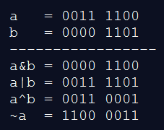
BASIC OPERATORS
II. PYTHON BITWISE OPERATORS
Bitwise operator works on bits and performs bit by bit operation. Assume if a = 60; and b = 13; Now in binary format they will be as follows −
a = 0011 1100
b = 0000 1101
-------------------------
a&b = 0000 1100
a|b = 0011 1101
a^b = 0011 0001
~a = 1100 0011
Operator | Description | Example
& Binary AND | Operator copies a bit to the result if it exists in both operands | (a & b) (means 0000 1100)
| Binary OR | It copies a bit if it exists in either operand. | (a | b) = 61 (means 0011 1101)
^ Binary XOR | It copies the bit if it is set in one operand but not both. | (a ^ b) = 49 (means 0011 0001)
~ Binary Ones Complement | It is unary and has the effect of 'flipping' bits. | (~a ) = -61 (means 1100 0011 in 2's complement form due to a signed binary number.
<< Binary Left Shift | The left operands value is moved left by the number of bits specified by the right operand. | a << 2 = 240 (means 1111 0000)
>> Binary Right Shift | The left operands value is moved right by the number of bits specified by the right operand. | a >> 2 = 15 (means 0000 1111)
There are following Bitwise
operators supported by Python language →

Slide 77
BASIC OPERATORS
III. PYTHON LOGICAL OPERATORS
There are following logical operators supported by Python language. Assume variable a holds 10 and variable b holds 20 then
Used to reverse the logical state of its operand.
Operator | Description | Example
and Logical AND | If both the operands are true then condition becomes true. | (a and b) is true.
or Logical OR | If any of the two operands are non-zero then condition becomes true. | (a or b) is true.
not Logical NOT | Used to reverse the logical state of its operand. | Not(a and b) is false.

Slide 78
BASIC OPERATORS
IV. PYTHON MEMBERSHIP OPERATORS
Python’s membership operators test for membership in a sequence, such as strings, lists, or tuples. There are two membership operators as explained below
Operator | Description | Example
in | Evaluates to true if it finds a variable in the specified sequence and false otherwise. | x in y, here in results in a 1 if x is a member of sequence y.
not in | Evaluates to true if it does not finds a variable in the specified sequence and false otherwise. | x not in y, here not in results in a 1 if x is not a member of sequence y.

Slide 79
BASIC OPERATORS
Example
a = 10
b = 20
list = [1, 2, 3, 4, 5 ];
if ( a in list ):
print("Line 1 - a is available in the given list")
else:
print("Line 1 - a is not available in the given list")
if ( b not in list ):
print("Line 2 - b is not available in the given list")
else:
print("Line 2 - b is available in the given list")
a = 2
if ( a in list ):
print("Line 3 - a is available in the given list")
else:
print("Line 3 - a is not available in the given list")

Slide 80
BASIC OPERATORS
Example
When you execute the program it produces the following result −
ma.a.d.serrano@PISI-7091S2N-LX MINGW64 ~/Desktop/python/scripts
$ python member.py
Line 1 - a is not available in the given list
Line 2 - b is not available in the given list
Line 3 - a is available in the given list

Slide 81
BASIC OPERATORS
V. PYTHON IDENTITY OPERATORS
Identity operators compare the memory locations of two objects. There are two Identity operators explained below −
Operator | Description | Example
is | Evaluates to true if the variables on either side of the operator point to the same object and false otherwise. | x is y, here is results in 1 if id(x) equals id(y).
is not | Evaluates to false if the variables on either side of the operator point to the same object and true otherwise. | x is not y, here is not results in 1 if id(x) is not equal to id(y).

Slide 82
BASIC OPERATORS
Example
a = 20
b = 20
if ( a is b ):
print("Line 1 - a and b have same identity")
else:
print("Line 1 - a and b do not have same identity")
if ( id(a) == id(b) ):
print("Line 2 - a and b have same identity")
else:
print("Line 2 - a and b do not have same identity")
b = 30
if ( a is b ):
print("Line 3 - a and b have same identity")
else:
print("Line 3 - a and b do not have same identity")
if ( a is not b ):
print("Line 4 - a and b do not have same identity")
else:
print("Line 4 - a and b have same identity")

Slide 83
BASIC OPERATORS
Example
When you execute the above program it produces the following result −
ma.a.d.serrano@PISI-7091S2N-LX MINGW64 ~/Desktop/python/scripts
$ python identity.py
Line 1 - a and b have same identity
Line 2 - a and b have same identity
Line 3 - a and b do not have same identity
Line 4 - a and b do not have same identity

Slide 84
BASIC OPERATORS
PYTHON OPERATORS PRECEDENCE
The following table lists all operators from highest precedence to lowest.
Operator | Description
** | Exponentiation (raise to the power)
~ + - | Complement, unary plus and minus (method names for the last two are +@ and -@)
* / % // | Multiply, divide, modulo and floor division
+ - | Addition and subtraction
>> << | Right and left bitwise shift
& | Bitwise 'AND'
^ | | Bitwise exclusive `OR' and regular `OR'
<= < > >= | Comparison operators
<> == != | Equality operators
= %= /= //= -= += *= **= | Assignment operators
is is not | Identity operators
in not in | Membership operators
not or and | Logical operators

Slide 85
BASIC OPERATORS
Example
a = 20
b = 10
c = 15
d = 5
e = 0
e = (a + b) * c / d #( 30 * 15 ) / 5
print("Value of (a + b) * c / d is ", e)
e = ((a + b) * c) / d # (30 * 15 ) / 5
print("Value of ((a + b) * c) / d is ", e)
e = (a + b) * (c / d); # (30) * (15/5)
print("Value of (a + b) * (c / d) is ", e)
e = a + (b * c) / d; # 20 + (150/5)
print("Value of a + (b * c) / d is ", e)
When you execute the above program, it produces the following result −
ma.a.d.serrano@PISI-7091S2N-LX MINGW64 ~/Desktop/python/scripts
$ python precedence.py
Value of (a + b) * c / d is 90.0
Value of ((a + b) * c) / d is 90.0
Value of (a + b) * (c / d) is 90.0
Value of a + (b * c) / d is 50.0
Notes:
Operator precedence affects how an expression is evaluated.
For example, x = 7 + 3 * 2; here, x is assigned 13, not 20 because operator * has higher precedence than +, so it first multiplies 3*2 and then adds into 7.
Here, operators with the highest precedence appear at the top of the table, those with the lowest appear at the bottom.

